Slide 1
The Swedish School of Textiles
This is

Slide 2
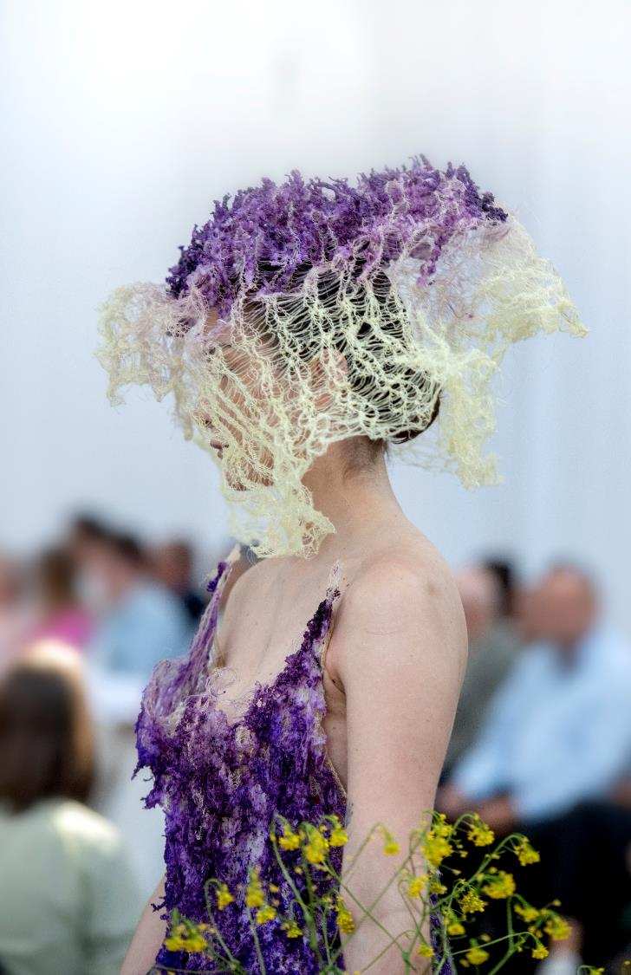
The Swedish School of Textiles
With courage and creativity, we lead research and education within textiles and fashion forward. The Swedish School of Textiles is the hub of a network woven by students, teachers, and researchers in a unique textile environment.

Slide 3
The Swedish School of Textiles
The Swedish School of Textiles is ranked in the top 10 among the world’s best fashion schools!
It is regarded as one of the world's most exciting educational and research environments within textiles and fashion.

Slide 4
The Swedish School of Textiles
Our expertise is in demand at the UN, by world-leading companies, and by students from across the globe.

Slide 5
The Swedish School of Textiles
Here, we produce ground-breaking research within the entire textile value chain, from the latest technical innovations, to the newest materials and most innovative circular solutions.

Slide 6
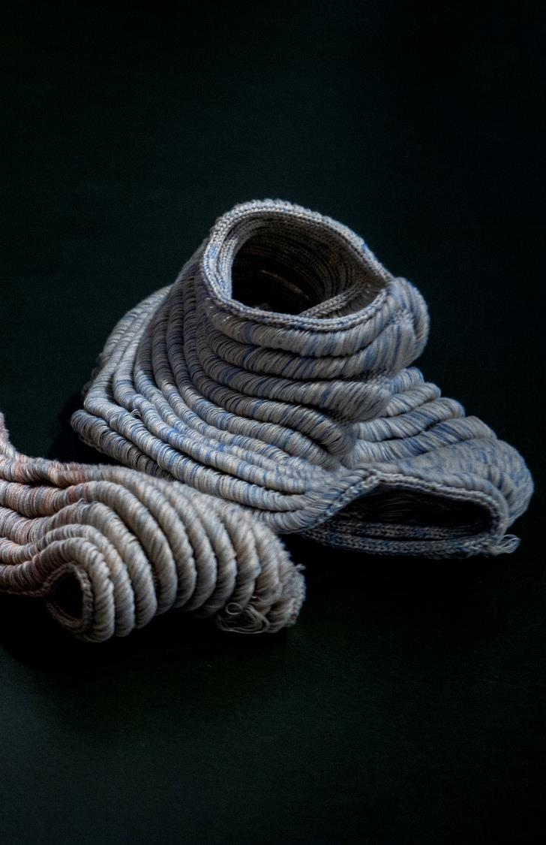
Management, design, and technology
The Swedish School of Textiles is a broad and complete academic environment with educational programmes at the Bachelor’s, Master’s, and doctoral levels and research in technology, design, and textile management. These three specialisations go hand in hand with technical solutions, cutting-edge design, and sustainable business models.

Slide 7
Management, design, and technology
Within this breadth, we also have exceptionally deep knowledge and expertise. Quite simply, we have excellence throughout the entire textile value chain that is unmatched in Sweden and leading internationally.

Slide 8
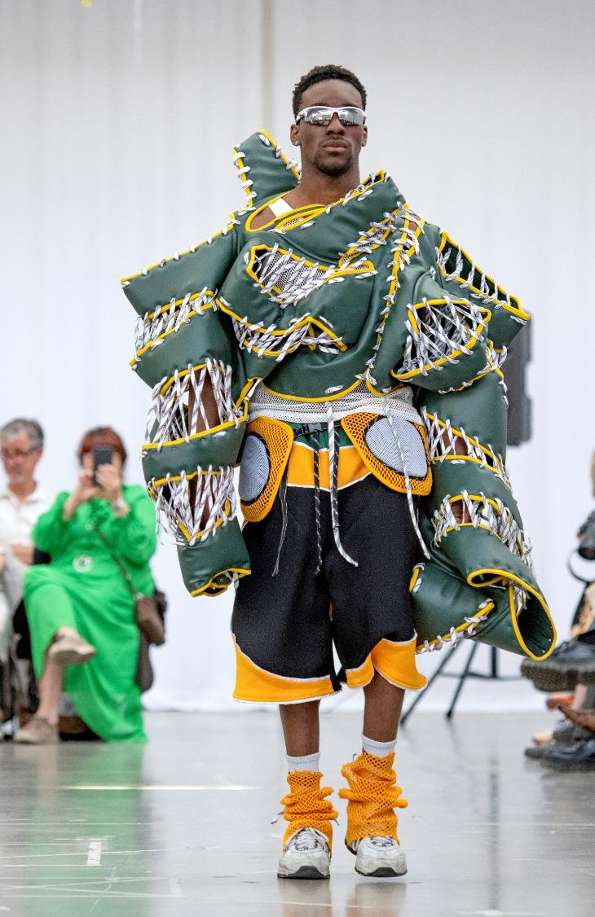
Educational programmes
7 Bachelor’s programmes (3 taught in English)
9 Master’s programmes (all taught in English)
Doctoral education programmes
Freestanding courses
Commissioned education

Slide 9
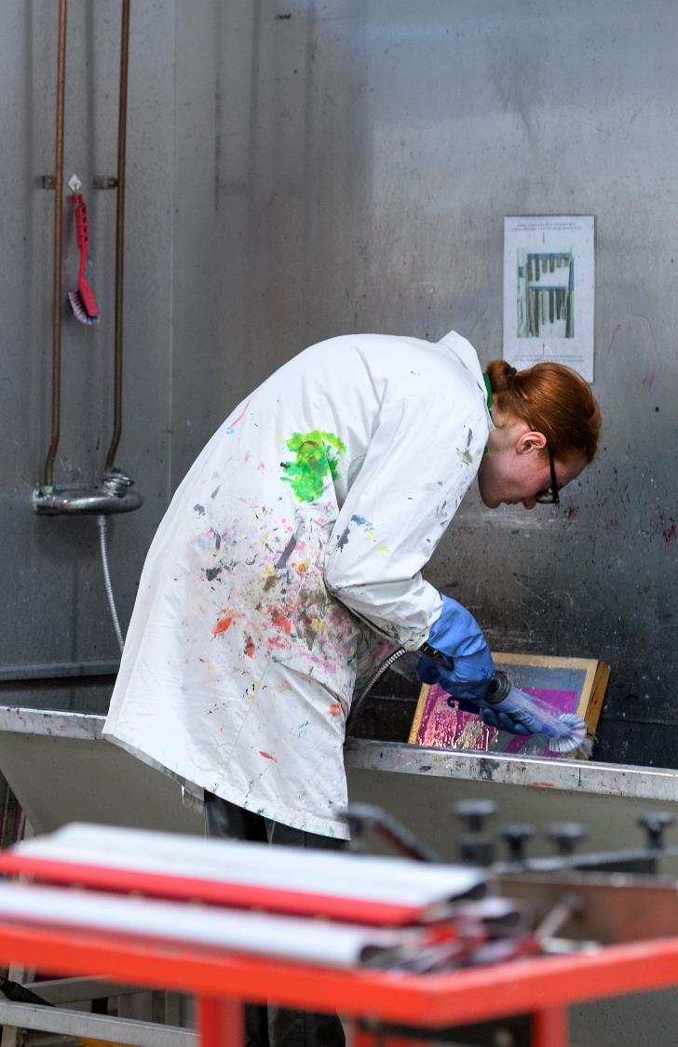
The labs
In our unique and advanced lab environments, creativity is combined with theory to create new ideas and masterpieces. Here, students, lecturers, and researchers turn their ideas into finished products.
Notes:
Digital Crafts Lab, Dye & Print Design lab, Knitting technology lab, Garment Technology lab, Weaving Technology lab, Dye & Print Technology lab, Textile Technology laboratories, Textile Testing lab.

Slide 10
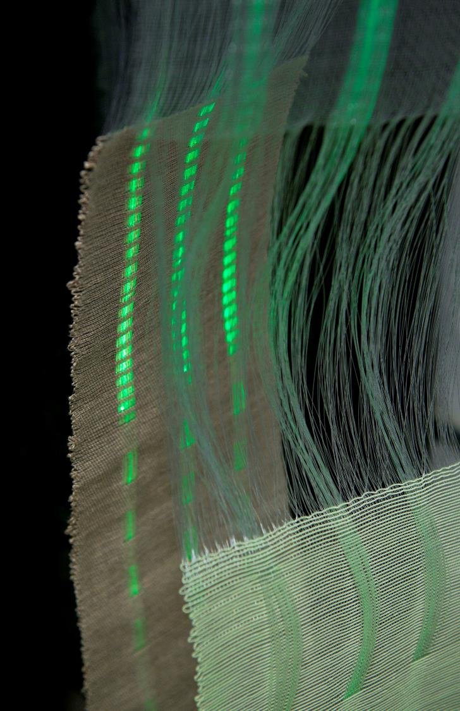
Research
Researchers at the Swedish School of Textiles tackle many exciting societal challenges! For example, research is conducted on customised clothing production, circular fashion, the relationships between body, material, and movement, and dyeing textiles without water.

Slide 11
Research
We are one of three higher education institutions in Sweden that are authorised to conduct both scientific and artistic research education, and we are the only one that does so in textiles and fashion.

Slide 12
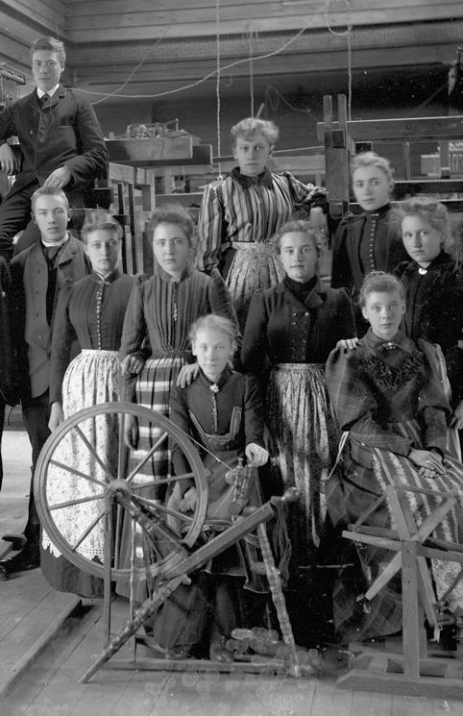
History of the Swedish School of Textiles
Borås has a long textile history; we have been a centre for expertise and knowledge ever since the Borås Technical Väfskola started up in 1866 – which became the foundation of the Swedish School of Textiles.

Slide 13
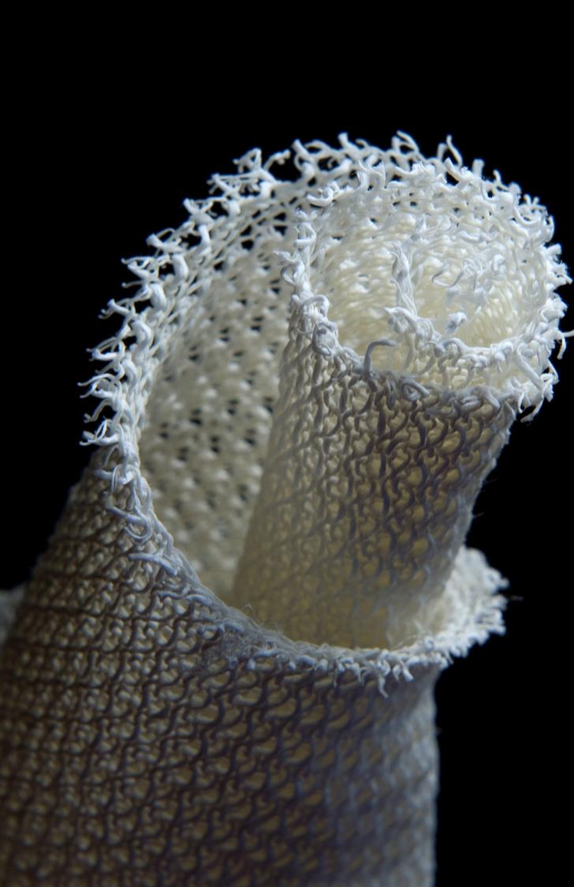
Smart Textiles
Here, textile innovations are developed, such as artificial muscles, clothes that measure pulse, sheets that detect if a patient has a fever, and knitted blood vessels to be used in bypass operations.

Slide 14
Smart Textiles
With over 500 research and business-driven projects since the initiative was founded in 2006, Smart Textiles has not only become a driving force for the textile industry in Sweden, but also an important player in the international arena.

Slide 15
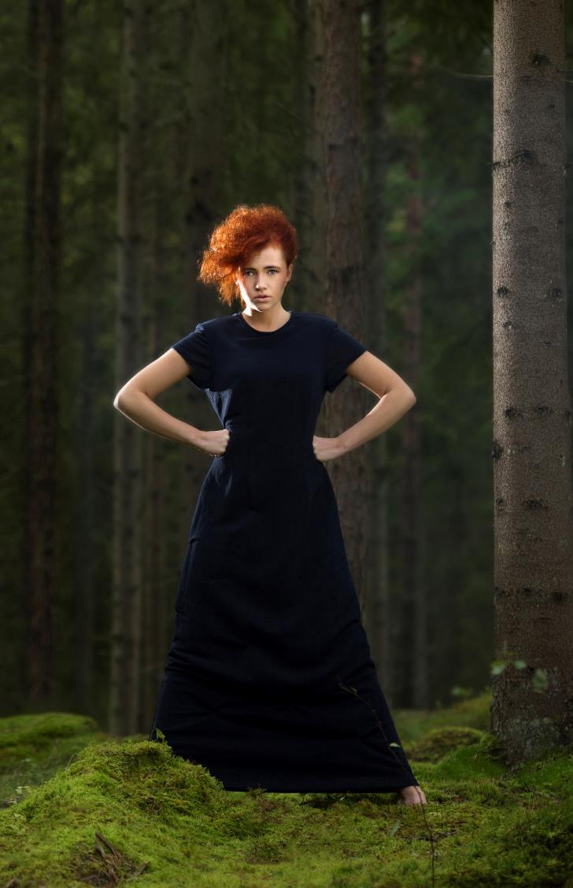
Science Park Borås
In the Textile Fashion Center, you will find Science Park Borås – an open collaboration arena with multiple stakeholders. Here, academia, industry, and other parts of society come together to realise ideas, develop, and generate new innovations, products, and services for the market.
Science Park Borås is part of the University of Borås and the Swedish School of Textiles.

Slide 16
Science Park Borås
Science Park Borås has a clear sustainability profile within its three areas of operation: textiles, consumption, and societal development. It is currently involved in several EU projects and is an active participant in the work on applications related to the European Green Deal.

Slide 17
Textile & Fashion 2030
Textile & Fashion 2030 is a national government role that is run from the University of Borås through Science Park Borås. The textile and fashion industry is one of the world's most resource-intensive and polluting industries and its impact on the goals of Agenda 2030 is significant in all parts of the value chain.

Slide 18
Textile & Fashion 2030
To interrupt this negative trend, a system change is required. The platform promotes cooperation between actors in the textile value chain and provides education, research and innovation, as well as supports new, sustainable business models.

Slide 19
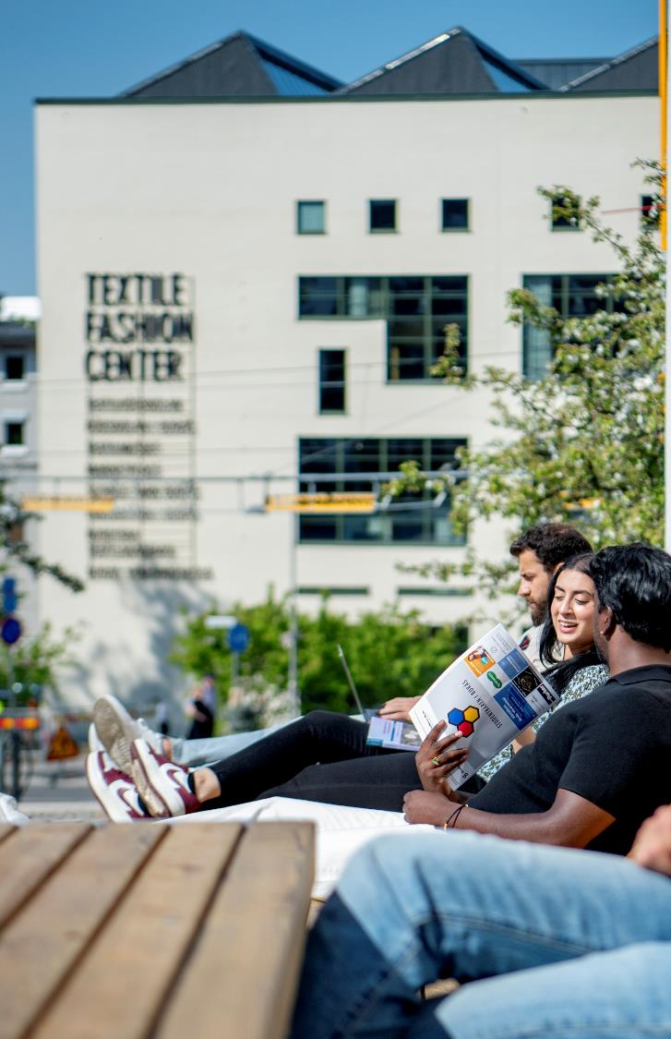
Textile Fashion Center
We are part of a textile hub and you will find several businesses under the same roof. In the Textile Fashion Center, students, companies and visitors gather in the same environment. An environment where dreams, needs and ideas are what inspire, challenge, and drive all involved.

Slide 20
Textile Fashion Center
In the Textile Fashion Center, something is always happening. It is a place for exhibitions, events, and activities where you can share knowledge and inspiration and meet other people with an interest in textiles, fashion, and societal development.

Slide 21
Thank you!

